Slide 1


OBD II norms and AL readiness
Feb 2023

Slide 2




Vehicular Emission and how it is controlled?
Pollutant | How it is formed | Control mechanism
 | Fuel burning at high temperature and burnt gases mixing with colder air and fuel vapour | Reduce peak firing temperatures – controlled by EGR introduction
 | Non-uniform mixture distribution within cylinder & slow oxidation resulting in incomplete combustion | Increase peak firing pressure and optimize in-cylinder air swirl – CRS
 | Over/Under mixing Overspray penetration Bulk quenching of combustion reactions | Fuel atomization, timing
 | Produced during combustion of rich fuel-air mixture and decomposition due to high temperature in absence of oxygen | Increase cylinder peak firing temperature
Timelines of Bharat Standards
Emission Standards for Truck and Buses, mg/kWh (WHTC)
Year | Bharat Standard | NO_{x} | HC | CO | PM
2000 | BS I | 8000 | 1100 | 4500 | 360
2005† | BS II | 7000 | 1100 | 4000 | 150
2010† | BS III | 5000 | 780 | 5450 | 160
2017† | BS IV | 3500 | 550 | 4000 | 30
2020 | BS VI | 460 | 160 | 4000 | 10
† - Progressive implementation

Slide 3
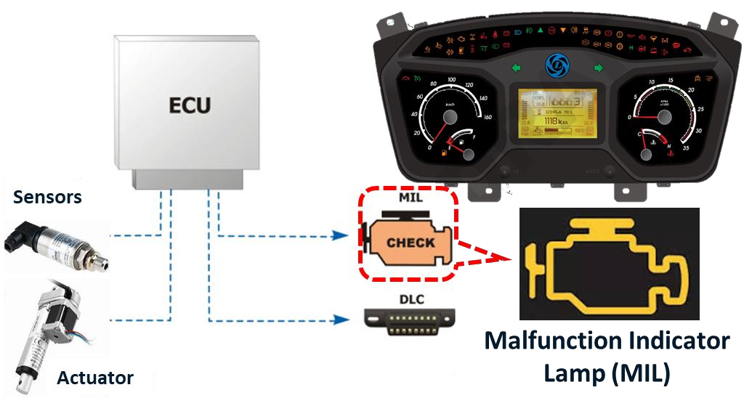

What is an OBD system?
OBD refers to “On-Board Diagnostics.”
It is a computer-based system designed to
monitor and control emission performance.
A basic OBD system consists of:
(Electronic Control Unit), which uses
ECU
input from various
Sensors
(e.g., NOx
sensors) to control the
Actuators
(e.g.,
fuel injectors) to get the desired performance.
Check Engine light, also known as the
MIL (Malfunction Indicator Lamp),
provides an early warning of
malfunctions to the driver
OBD system is similar to sensory system of human bodies, which enables data collection, processing and take action.
Inputs
Processor
Actuator

Slide 4
How OBD system monitors emission?
What is monitored in an OBD system?
ETM (Emission Threshold Monitoring) to monitor if emission limits are being exceeded
How emission threshold monitoring is done?
OBD checks system for any malfunctioning as well as DEF quality / quantity.
What happens when an OBD system detects an abnormality?
It alerts the driver by the way of warning lamp on dashboard
Alert will be triggered once emission level in exhaust pipe crosses specified limit.
What happens when the alert (warning lamps) is triggered?
No need to panic – system allows sufficient time for vehicle to reach the nearest AL
authorized service point for attending the same.
If these alerts are ignored for a longer period of engine running time, torque reduction followed by speed reduction will be triggered

Slide 5
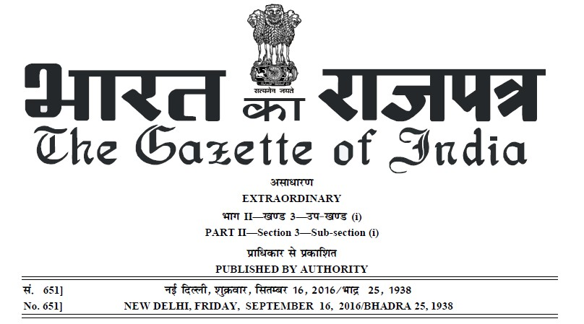
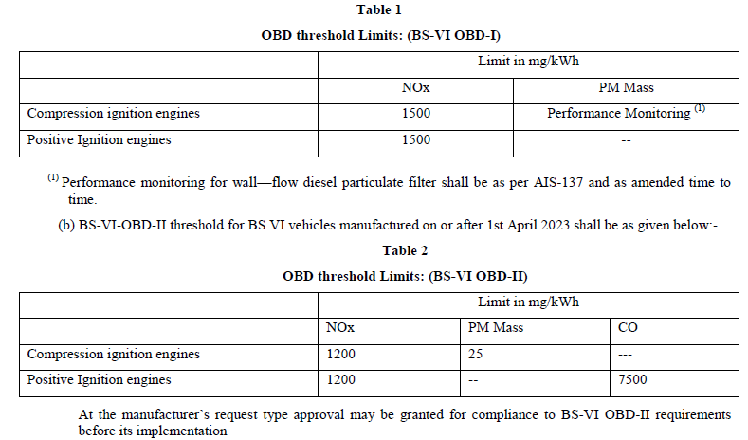
OBD II mandate is effective 1st April 2023
From when OBD II norm is effective?
Applicable only for vehicles manufactured on or after 1st April 2023. This has been notified as early as Sep 2016 vide gazette notification.
What are the differences between OBD I and OBD II?
OBD-II has more stringent alert limits for the emission parameters than OBD I.
These stringent limits are only for generating alerts
/ take action by ECU – No change in emission standard.

Slide 6

OBD II norms - India’s emission control journey
No change in emission standards from BSVI OBD I to OBD II
Emission
Standard
BSIII / BSIV in select
territories
BSIV – pan India
BSVI
On Board
Diagnostics
None in BSIII / OBD in BSIV
BSVI – OBD I
BSVI – OBD II

Slide 7
What is OBD II norm ?
BSVI OBD II is all about stringent diagnostic threshold limits
BSVI OBD II norm is all about quicker alert in case of emission detoriation
No change of emission standard (unlike BSIII to BSIV etc.,)
Change in BSVI OBD II over OBD I alert trigger levels
OBD requirements (mg/kWh) | NOx | PM
BSVI standard | 460 | 10
OBD I threshold | 1500 | Only monitoring
OBD II threshold | 1200 | 25
OBD requirements (mg/kWh) (due to DEF related issues) | NOx
BSVI standard | 460
OBD I threshold | 900
OBD II threshold | 460
AL vehicles will retain the same power/torque level for OBD II vehicles also
No performance difference will be felt by AL customers - in terms of fluid efficiency and driveability
No new additional error alerts in OBD II over OBD I vehicles.
Quality of Diesel and DEF will be critical in OBD II vehicles.

Slide 8



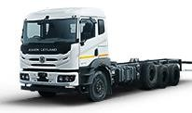
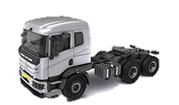
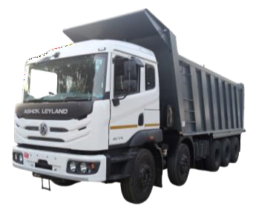
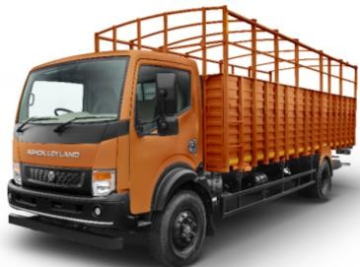
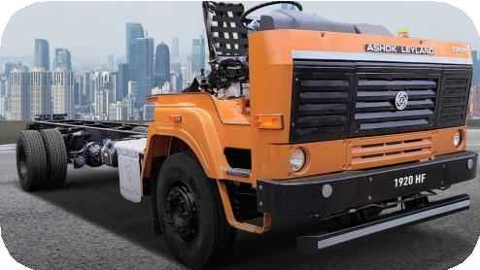


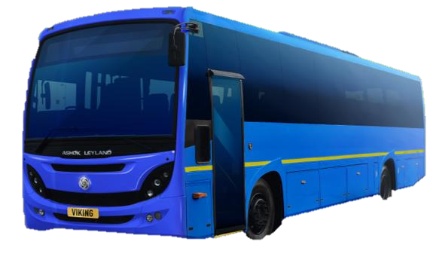
AL is ready with OBD II compliant vehicles
Tippers
ICV Trucks
4x2 Haulage
MAV Trucks
Tractors
Tippers
ICV Buses
MCV buses

Slide 9
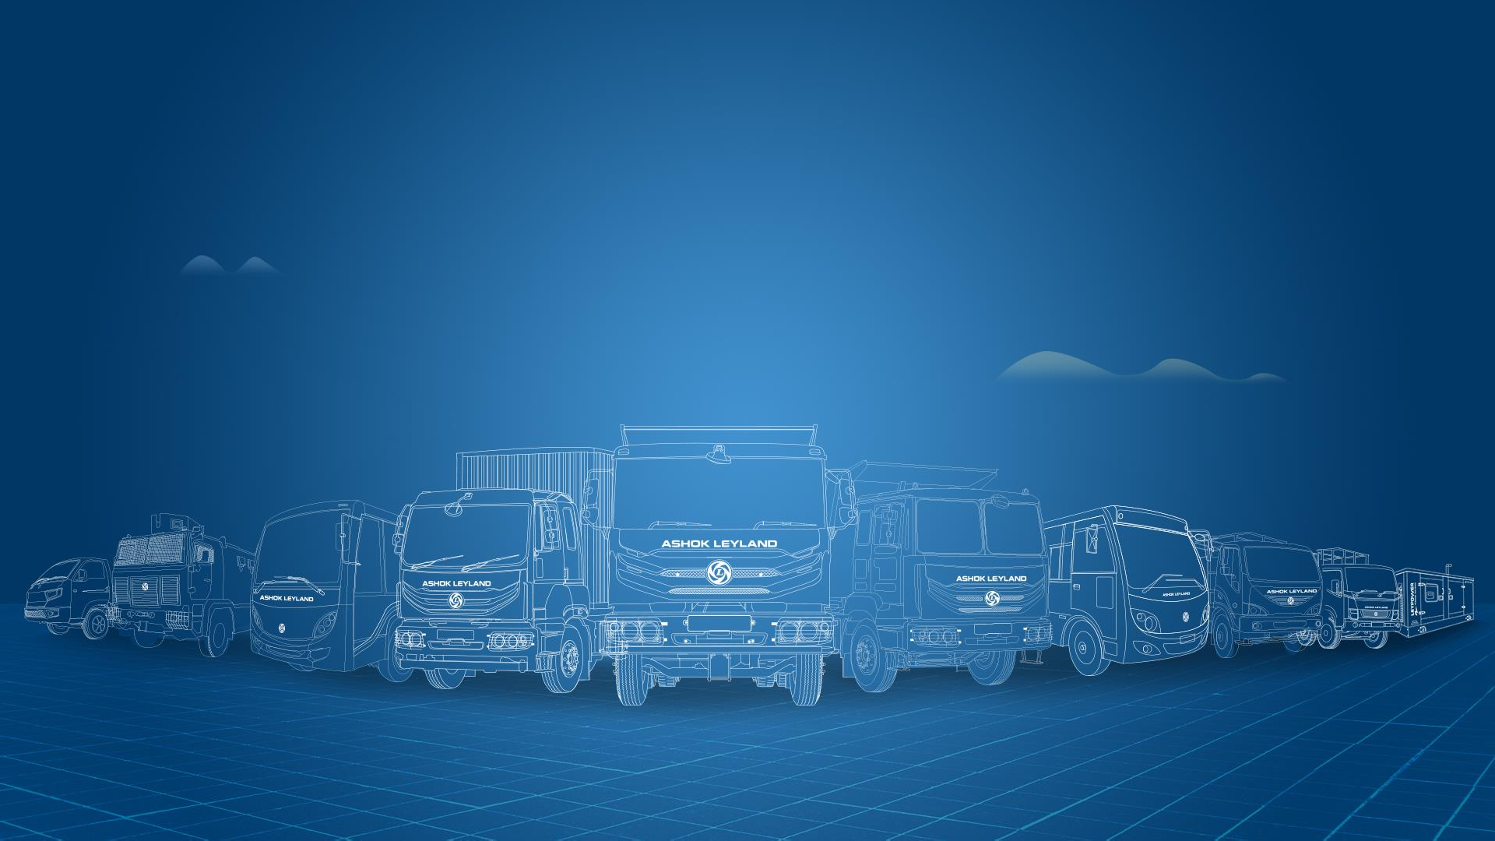

Thank You

